Slide 1
Human Resource Management
Human resource management (HRM) is the process of employing people, training them, compensating them, developing policies relating to them, and developing strategies to retain them.
People with relevant skills and values are generally called as Human Resources.
Many changes over the last twenty years.
HRM) is concerned with the “people” dimension in organizations.
The goal of HRM is to maximize employees’ contributions in order to achieve optimal productivity and effectiveness

Slide 2
Definition
Leon C. Megginson explained the term human resources as “the total knowledge, skills, creative abilities, talents and aptitudes of an organization's workforce, as well as the value, attitudes and beliefs of the individuals involved.
Edwin Flippo as “planning, organizing, directing, controlling of procurement, development, compensation, integration, maintenance and separation of human resources to the end that individual, organizational and social objectives are achieved.”
Notes:
term HR is not restricted to just a collection of people as such, rather it has the philosophy of treating a person in totality with all the talents and creative potential.

Slide 3
Definition
The National Institute of Personnel Management (NIPM) of India has defined human resource as “that part of management which is concerned with people at work and with their relationship within an enterprise. Its aim is to bring together and develop into an effective organization of the men and women who make up an enterprise and having regard for the well-being of the individuals and of working groups, to enable them to make their best contribution to organizational success.”

Slide 4
Nature of HRM
Universal Force
Action Oriented
Individual Oriented
People Oriented
Future Oriented
Development Oriented
Integration Mechanism

Slide 5
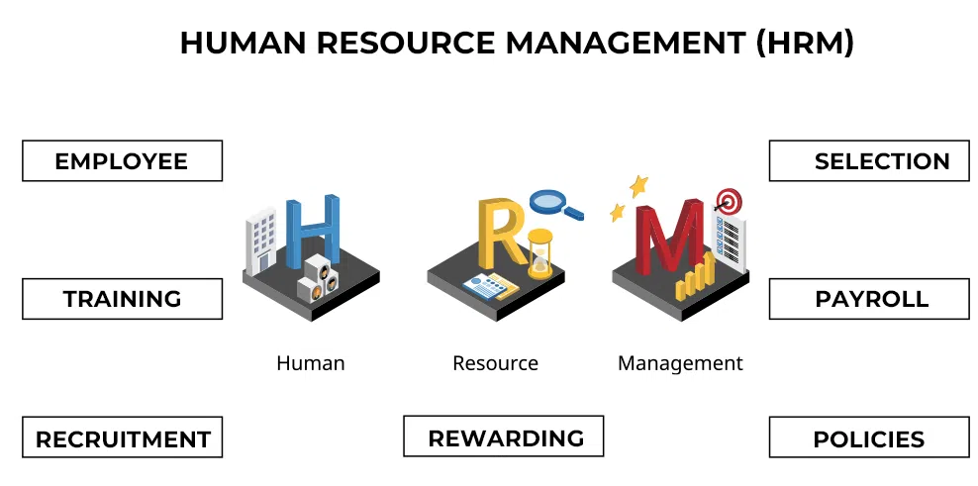

Slide 6
Scope of HRM
Manpower Planning
Employee Hiring
Employee Rewards
Employee Development
Performance Management
Industrial Relations
Notes:
Source: American Society for Training and Development

Slide 7
Importance of HRM
Social Significance
Professional Significance
Organisational Significance

Slide 8
Evolution Of HRM
The concept of HRM has developed through a number of stages. They are as follows :
Industrial revolution (late 18th to early 19th century)
Workers moved from farms to factories.
Workers were treated like machines.
Management focused mainly on productivity, not employee welfare.
2. Scientific management (early 20th century)
Focused on improving efficiency through scientific methods
Workers followed fixed methods to increase productivity.
Workers were trained to follow precise instructions

Slide 9
3. Trade unionism
Workers formed unions to protect their rights.
Focus on fair wages, better working conditions, and job security.
Collective bargaining became important.
4. Human relations movement (1920s–1930s,)
Focus on teamwork, communication, and leadership.
Showed that attention to employees improves productivity.
Recognized that employee motivation isn’t just about money.
5. Human resource approach
Employees are viewed as valuable assets (human capital).
Focus on development, engagement, and long-term growth.
Aligns employee goals with organizational goals.

Slide 10
Functions of HRM
Managerial function
Operational function
Planning
Organizing
Directing
Coordinating
controlling
Employment
HR Development
Compensation
Human Relations

Slide 11
Principles of HRM
Principles of Individual development
Scientific selection procedure
Principles of incentive
Principles of participation
Principles of team spirit
Principles of fair compensation
Adequate communication

Slide 12
HRM v/s Personnel Management
HRM | Basis | Personnel Management
Modern | Approach | Traditional
Its philosophy is to develop the people as per their aspiration, Goals and motivate them to achieve the organizational goals. | Meaning | It is concerned with procurement and development of personnel to achieve the organization objectives.
Resources | Employee Treatment | Machines/Tools/Product.
On the basis of Performance | Salary | On the basis of Job Evaluation.
Fast | Decision Making | Slow
Business needs or need base. | Management Actions | Procedure/ Routine.
Transactional. | Management Role | Transformational .

Slide 13
HRM in India
Recruitment, training and development
Induction
Retention strategy
HR Development
Leadership

Slide 14
Objectives of HRM Models?
This provide analytical framework of HRM that establishes relationship among various variables to be researched.
They serve as a heuristic device that help us to discover and understand the world for explaining the nature and signification of key HR Practice.

Slide 15
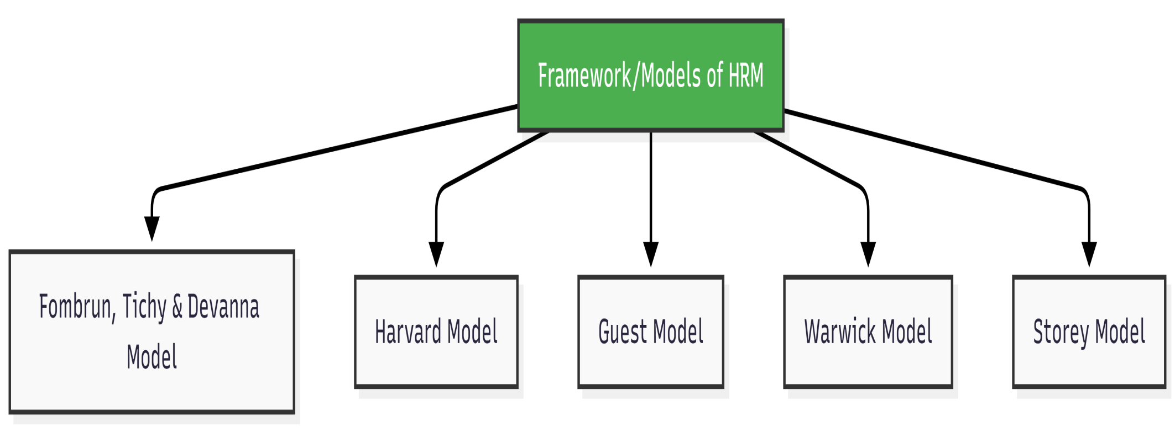
Model Of HRM

Slide 16
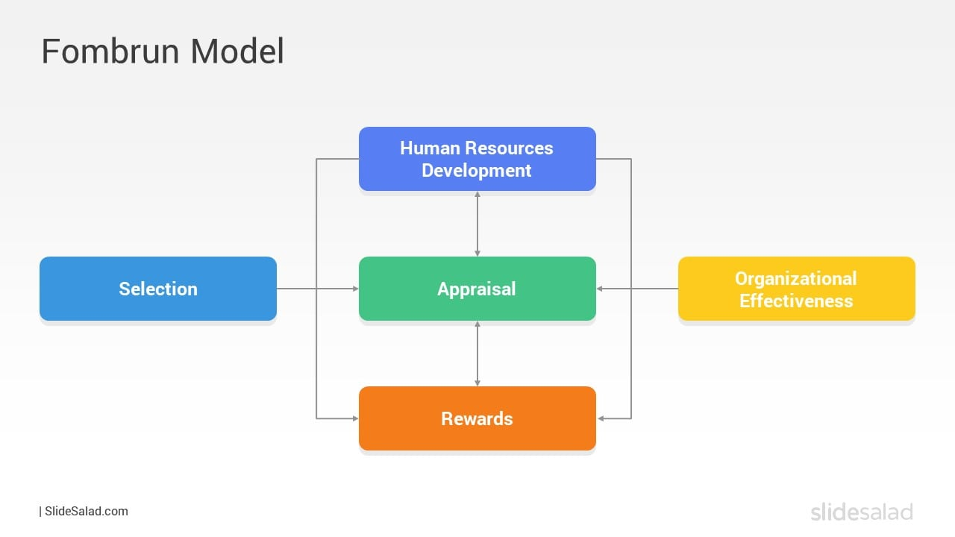
Fombrun, Tichy and Devanna model
one of the first models focussed only four functions of HRM.
Selection, HRD, Rewards, Appraisal are inter connected and lead to organizational effectively.
Model was too simple however at the same time did not environmental factor. Considered
it only considered four functions of HRM.

Slide 17
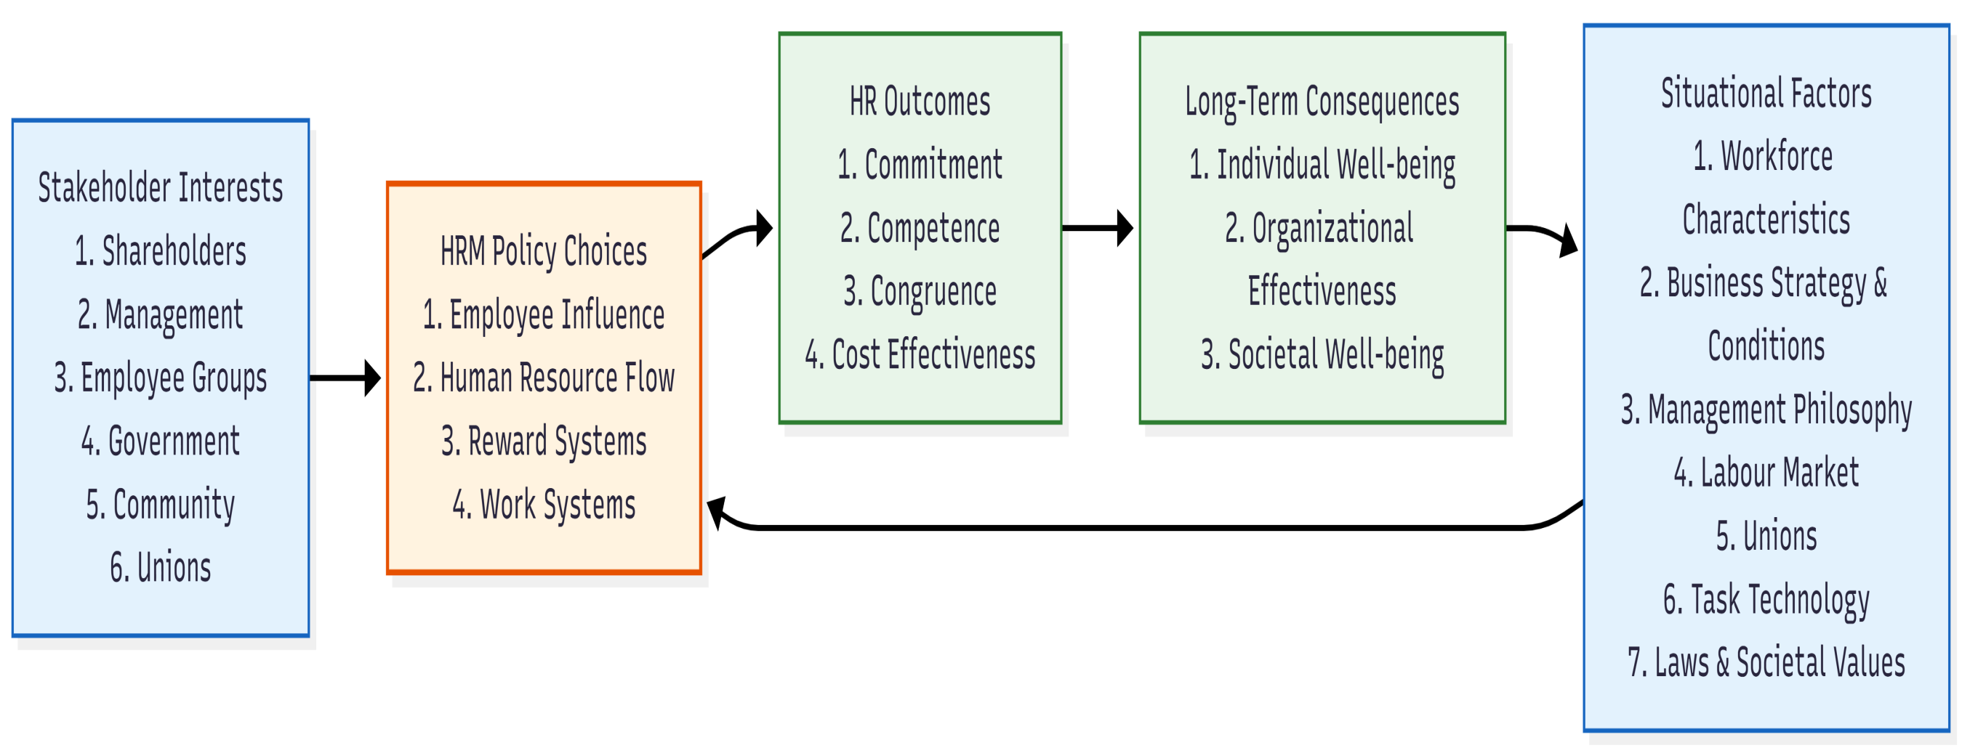
Harvard Model

Slide 18
Harvard Model
it included 6 components.
Stake holder Interest
HRM components
Situational factors
HR outcomes
Long term outcomes
Stakeholder Interest An organization is surrounded with different parties who are bit directly or indirectly affected with the organization activities.
An organization must balance the relationship between their profits, social contribution, shareholder interest and regulations as well

Slide 19
Situational Factors
There are factors which are internal or external but they are based on situations
Government regulations
Labour market
Technology
HRM Policy Choice Area
Human Resource flow includes functions like recruitment, Selection, training, promotion, retirement and termination.
Reward Systems are designed to motivate employees that include pay systems, incentive and bonus.
Employee influence incorporate the level of authority and associated responsibility
Work system is integrating all these function together so that they can executed in a flow and run like a system.

Slide 20
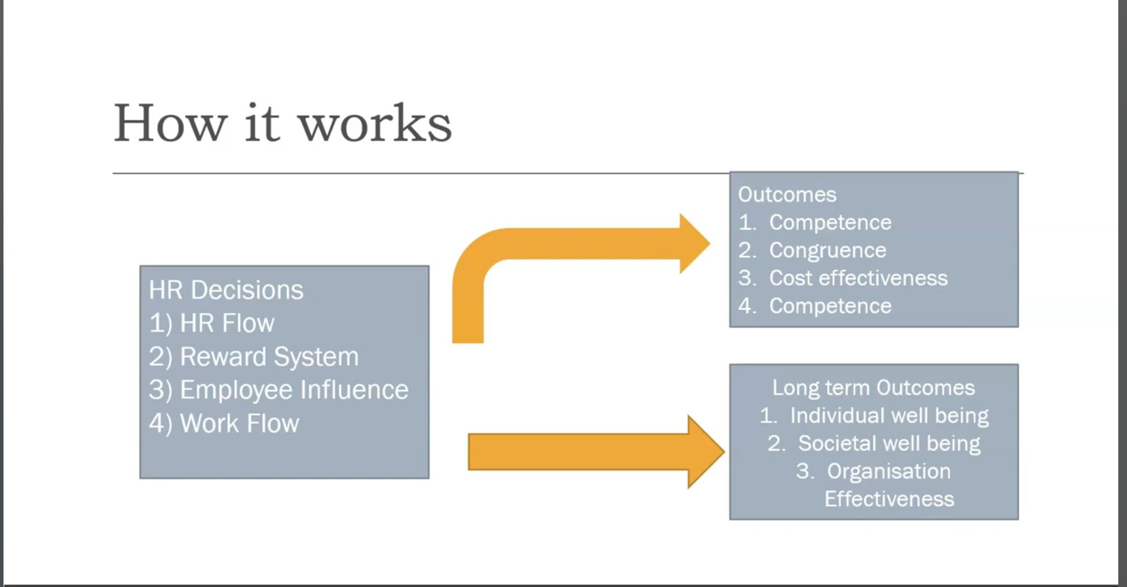

Slide 21
WarWick Model
The Warwick HRM Model was constructed by the researchers Chris Hendry and Andrew M. Pettigrew at the University of Warwick in the early 1990s.
Developed from the Harvard Model, this HRM framework represents an analytical approach to HRM.

Slide 22
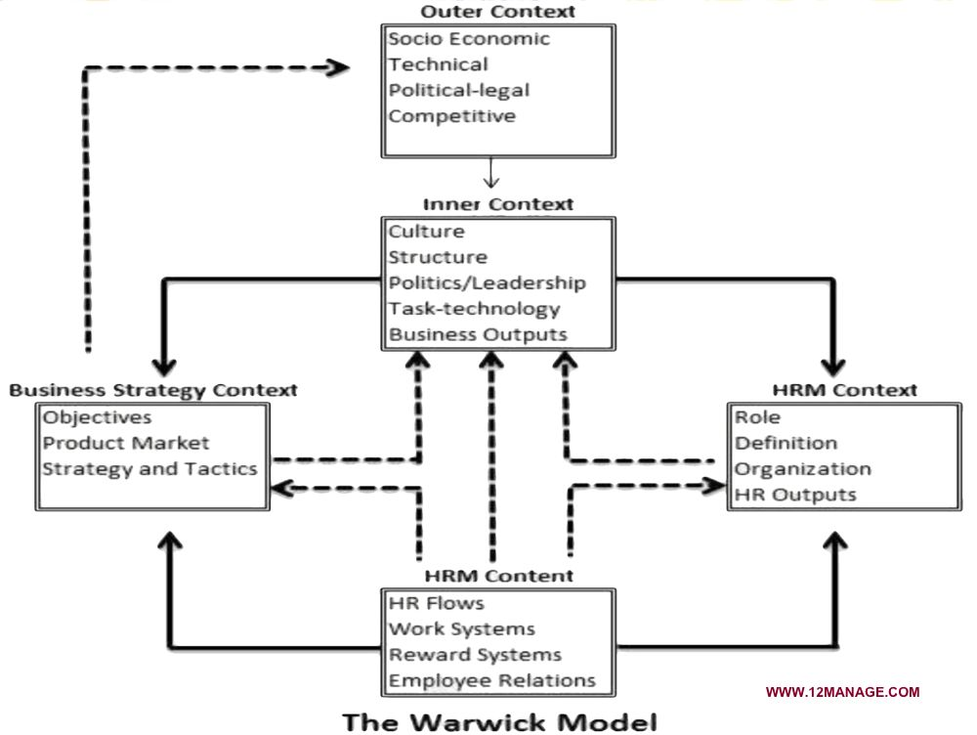
Warwick Model

Slide 23
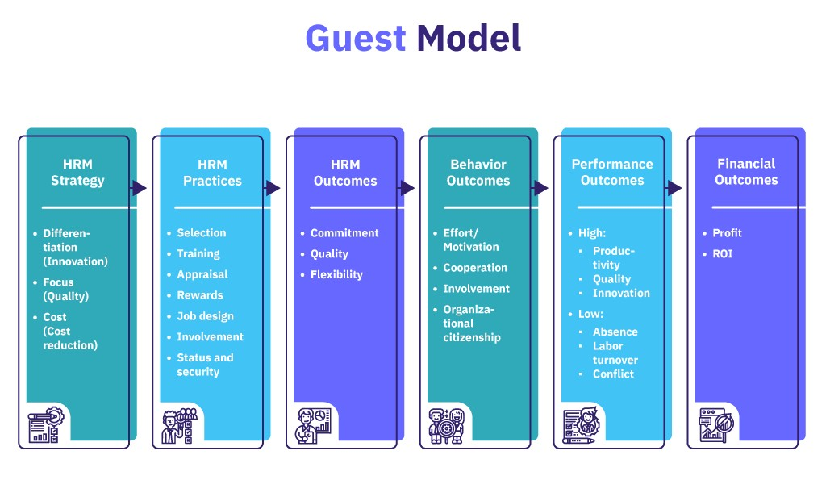

Slide 24
5 P Model
The 5P's HRM Model is a form of strategic HRM developed in 1992 by Randall S. Schuler, a praised scholar.
Dedicated to the matters of global HRM, strategic HRM, the function of HRM in organizations and the interface of business strategy and human resource management.
As its name suggests, The 5P's Model is based on five constitutional aspects: purpose, principles, processes, people, and performance.
According to this framework, aligning and balancing these five principles leads to achieving company success.

Slide 25
Factors Influence Human Resource Management
External Factor
Economical Environment
Technological change
Political and Legal Environment
Social and Cultural factor
2. Internal Factor
Organizational goals and objective
Organizational structure
Size of the organization
Financial Resources

Slide 26
The HR Competency
Technical competency
Behavioral competency
Business competency
Strategic competency
Ethical competency
Change management competency

